Slide 1
Exploring the world of Data Science and the related jobs in the field
PRESENT BY
YAN XU
HAO BAI
ESCOFFREY THOMAS

Slide 2
BACKGROUND
Over the last six months we immense ourselves into the Universe of BIG Data aka
“Data” as we journey into the world of Data Science on the Python Shuttle.
Our mission: to gain an in-depth understanding and increase knowledge of Data Science
Acquiring the skills and mastering the techniques to extract, transform and load our data
Performing various analyses to obtain valuable information, knowledge to provide recommendations and using Machine Learning to make predictions.
Give life to our results through dynamic visualization.
Now we are ready to launch our careers in Data Science, but, first we have to perform a job search, apply for the job, demonstrate our knowledge and skills in a convincing way that our choice company will offer us the job.

Slide 3
INTRODUCTION
Searching for a job can be a daunting task and giving that we are new to the field of Data Science will not make it any easier. As such we have embarked on our mission to explore and determine the state of the US Data Science job market as our final project.
Data Science is fairly new and growing profession that offers exciting careers, but what are the job options, what are the duties, what are the requirements and valued skills, how much does these jobs pay, where are the jobs and which companies are hiring.
As such, we decided to tackle these questions to assist us and other Data Science enthusiasts in performing a data driven job search.

Slide 4
SOURCE OF DATA
Kaggle.com: Data Scientist Jobs in the US as scraped from Indeed website (August 2018) and downloaded as a csv file. The file contains Company Name, Job Title, Location, Job Description and Number of Company Reviews.
Kaggle.com: 2018 Survey results of Data Science jobs in the US download as a csv file. This file includes information such as Salary, Education, Gender, Experience, Employment Status and Job Satisfaction.

Slide 5
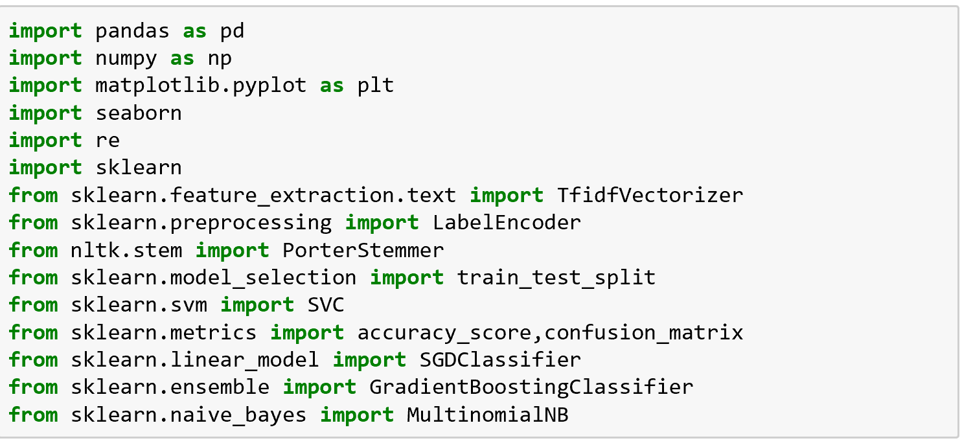
DEPENDENCIES
The downloaded csv data files were read into pandas using Juypter Notebook to perform data transformation and do the analysis
We store the results as JSON files.
JavaScript library and CSS were used for making custom interactive web-based data visualizations

Slide 6
What is Data Science?
Data science is a multi-disciplinary field that combines several disciplines, including statistics, data analysis, machine learning, and computer science. Data science uses scientific methods, processes, algorithms and systems to extract knowledge and insights from structured and unstructured data

Slide 7
Data Scientist: An analytical data professional with a high degree of technical skill and knowledge, usually with expertise in programming languages such as R and Python.
Data Analyst: An interpreter of data who typically specializes in identifying trends.
Data Engineer: Anyone who designs, QAs, and maintains the systems that data scientists employ daily and focuses more on data preparedness.
Machine Learning Engineer: takes the prototyped model determined by the Data Scientist and makes it work in a production environment at scale

Slide 8
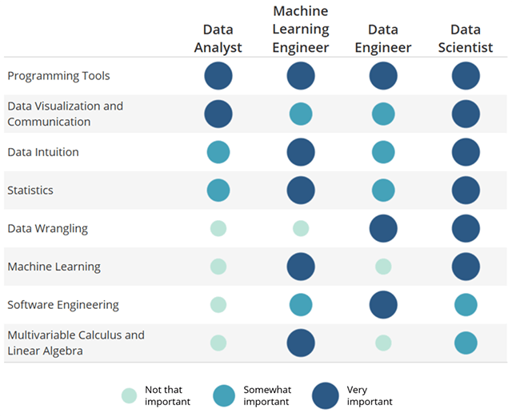
TOP 4 Data SCIENCE

Slide 9
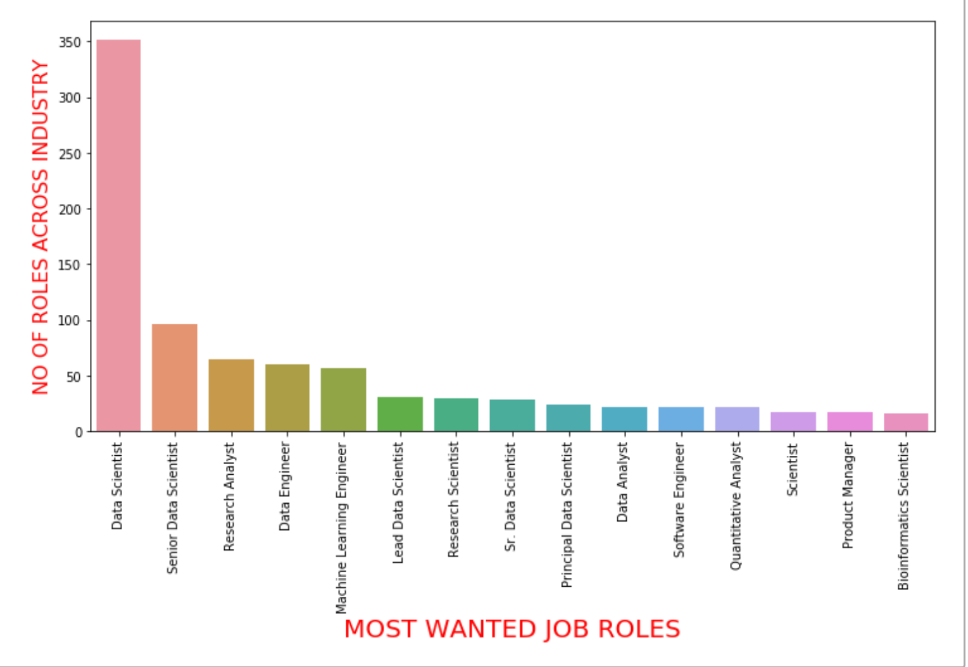
Which are the most in demand jobs?

Slide 11
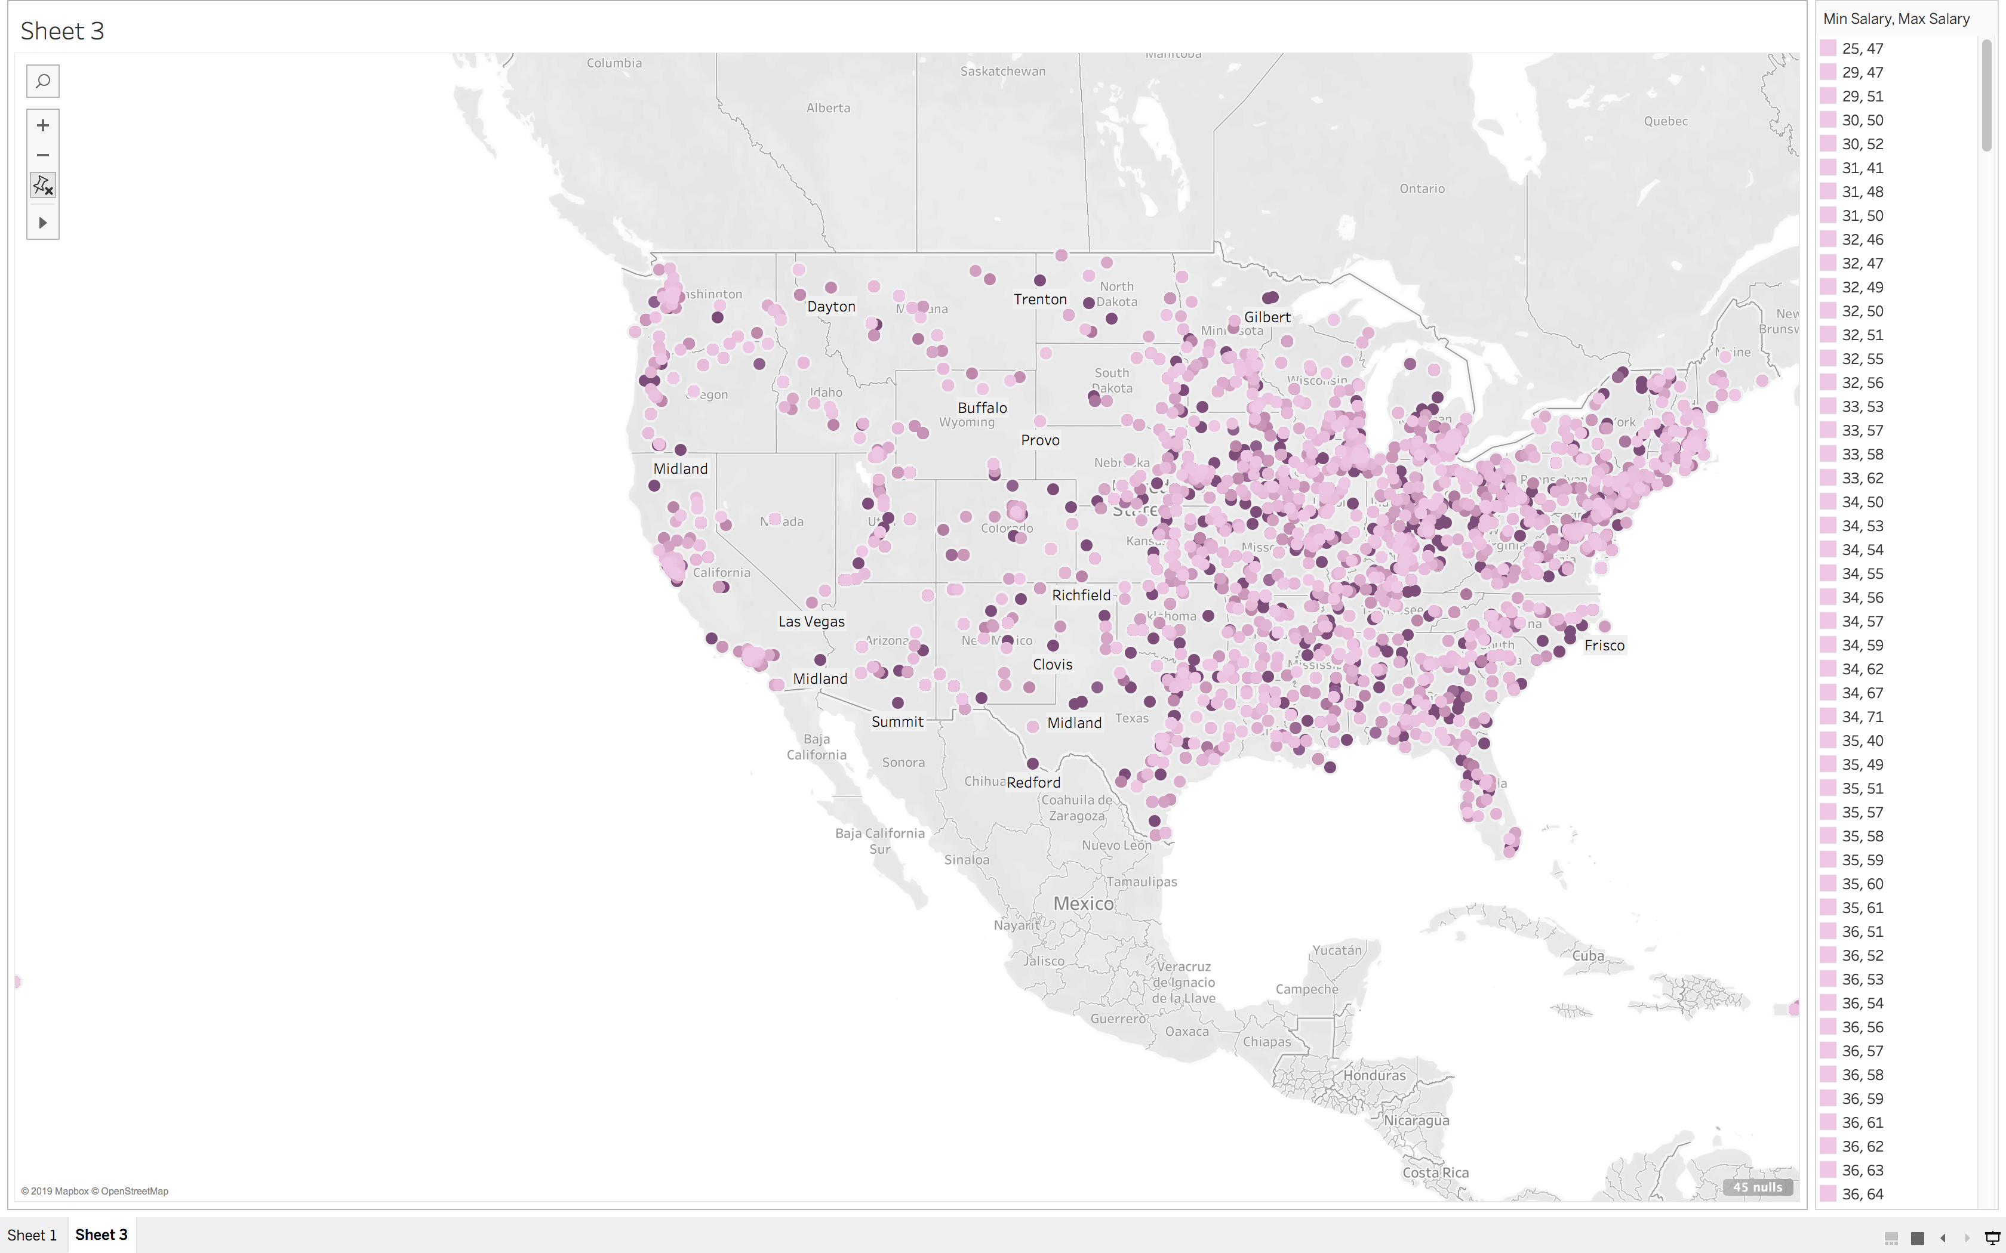

Slide 12
Opportunities for Future Analysis and Improvements
We could use a machine learning module where a job searcher input their skill sets and have return a list of recommend jobs to apply for?
Based on selected criteria: location, salary, company size, industry, etc. will we be able to predict job satisfaction rating?
Clean the descriptions to particularly outline which responsibilities and qualifications are required for each position. This would help to remove company related descriptions and focus on what actually is required of each position.
Compare job posting from sites such as Glassdoor, Indeed and Linkedin.

Slide 13
Conclusion
The current and future demands for Data Science professionals remain very due to the explosive growth in the volume of data and its’ impact in every business sector. This is driving up the number of data science professionals required to help companies uncover the insights they need to stay competitive. These jobs often prove to be challenging, takes an average of five days longer to close the market average, causing employers to pay premium data science salaries for qualified professionals
Data science is changing the way we work and opening up new frontiers leading to new fields of prediction and data visualization through artificial intelligence and machine learning. Although in the future data science will be increasingly automated as a result, the need for human judgment to interpret the data will not disappear any time soon given the number of job vacancies. As such, the data science skills will continue to pay huge dividends in our increasingly data-driven world.

